Slide 1
Virtual Learning vs Physical School
Sushil Varma

Slide 2
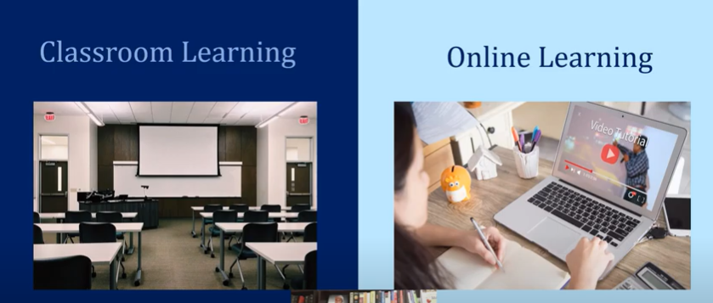

Slide 3
Physical Classroom
Physical classrooms create a face-to-face environment for students and teachers. They refer to a classroom set-up where everyone can communicate with each other and engage.
Online Classroom
An online classroom is a digital learning experience that allows teachers and students to connect online in real-time. Online classrooms use video conference, online whiteboards, and screen sharing to enable teachers to conduct live lectures,, and discussions with students in an interactive setting.

Slide 4
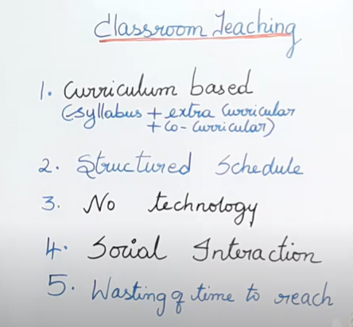
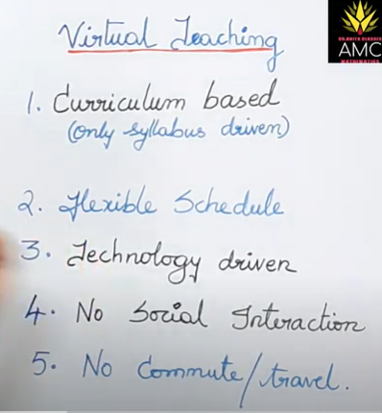

Slide 5
Thank You

